Slide 1
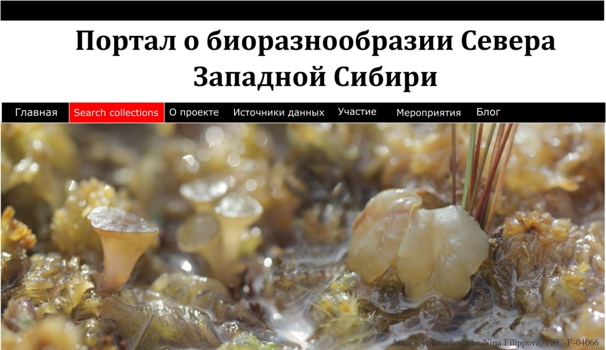
Biodiversity portal of Northern West Siberia
Data digitization and mobilization initiative
Filippova N.V., Lapshina E.D.
Yugra State University
https://nwsbios.org

Slide 2
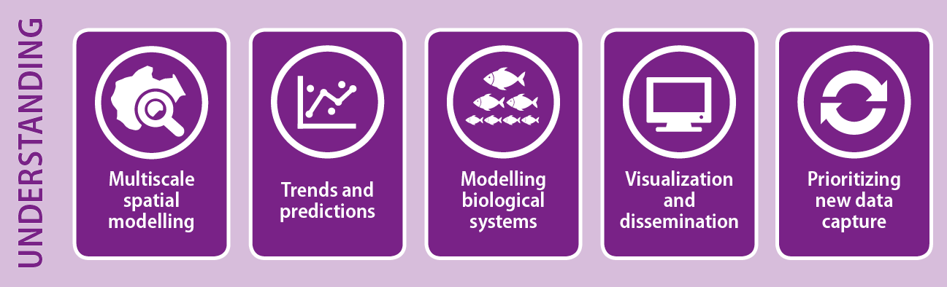
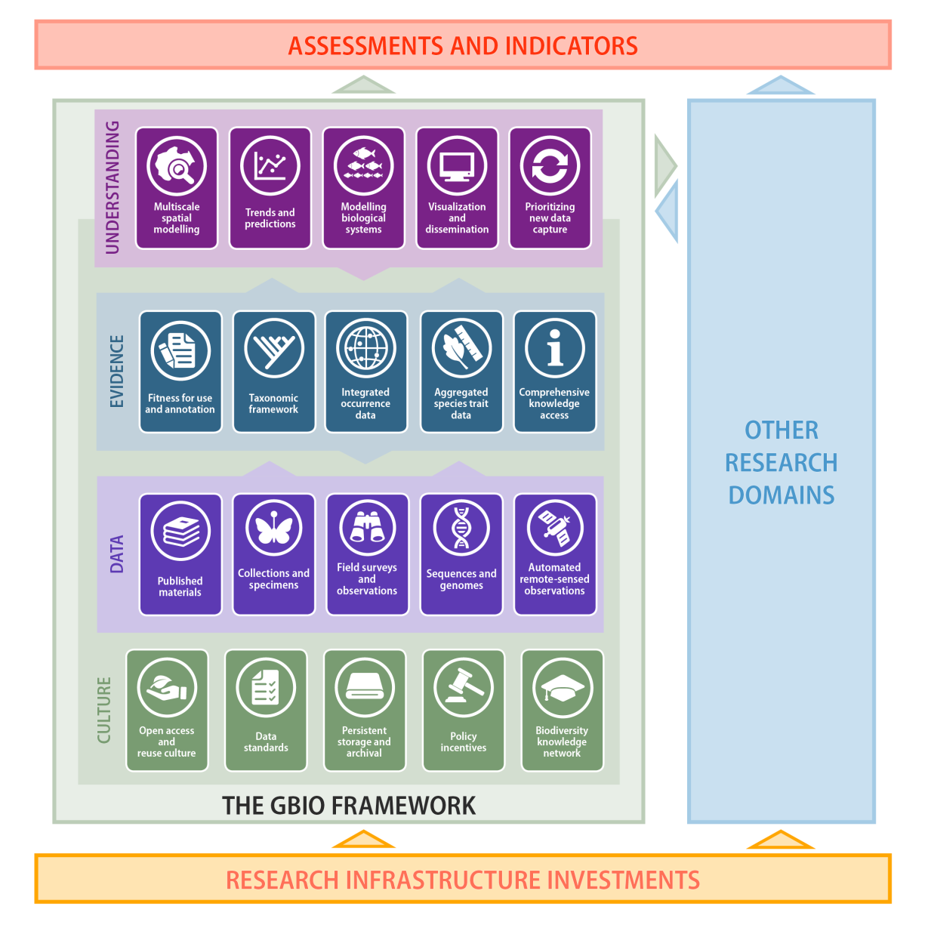
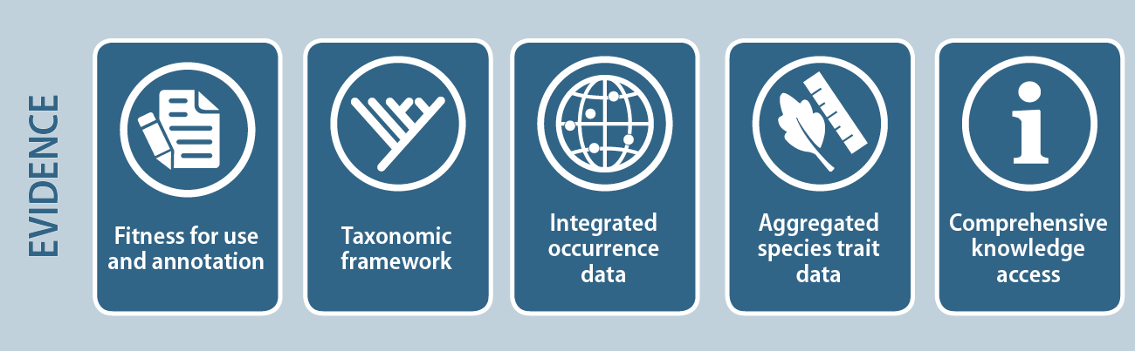
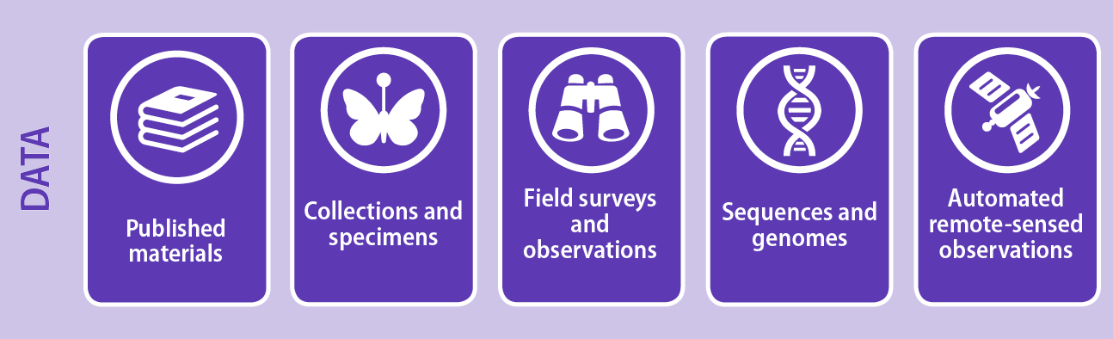
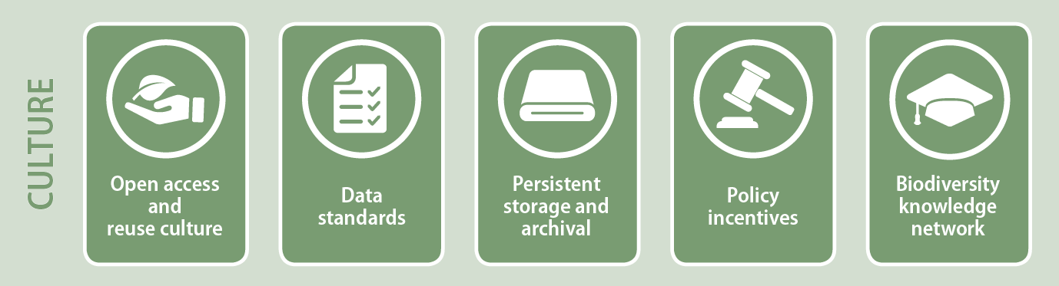
Global Biodiversity Informatics Outlook
https://www.biodiversityinformatics.org/
Hobern, Donald, et al. "Connecting data and expertise: a new alliance for biodiversity knowledge."
Biodiversity data journal 7 (2019).

Slide 3
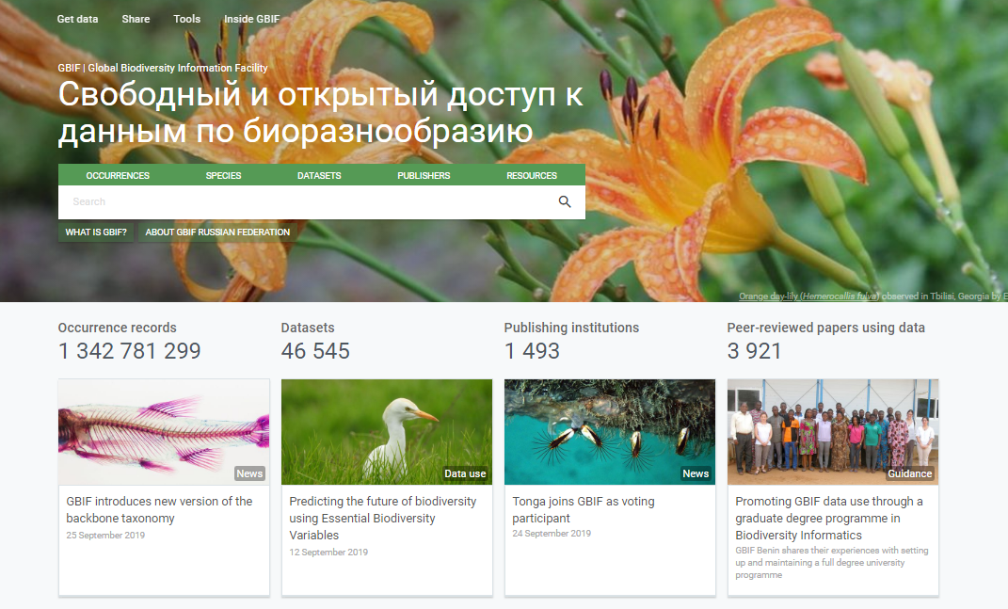

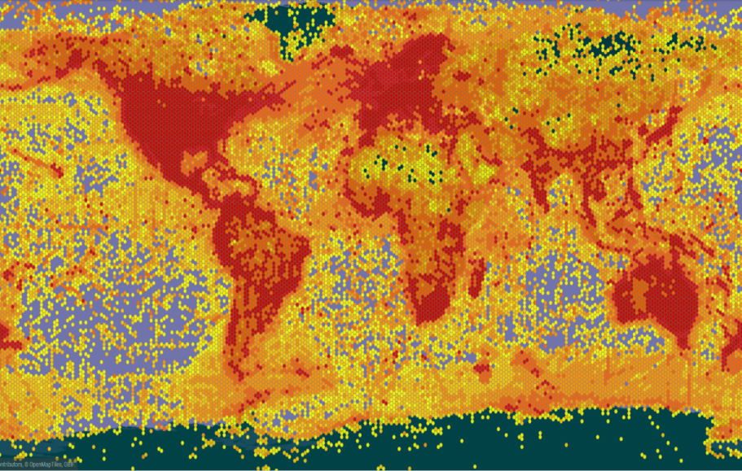
Global Biodiversity Information Facility
https://www.gbif.org/
International open data infrastructure
Funded by the governments
of the participant countries
Network for free and open access to biodiversity data
98 participants: 59 countries and 39 organisations
https://www.gbif.org/the-gbif-network

Slide 4
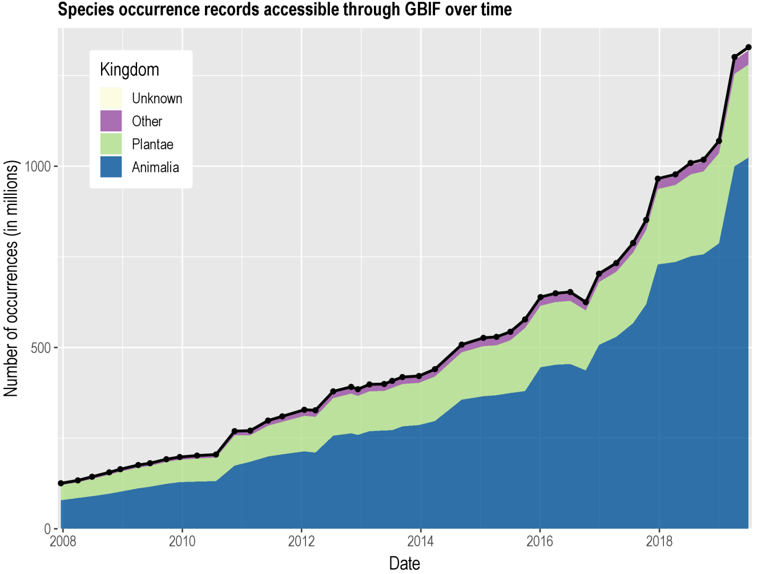
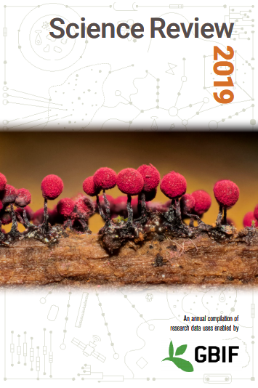
Data published through GBIF.org and Science Review 2019
data availability
www.gbif.org/analytics/global
https://www.gbif.org/science-review

Slide 5
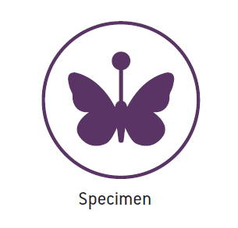
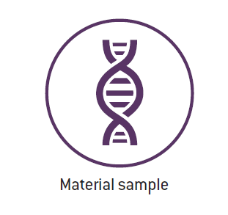
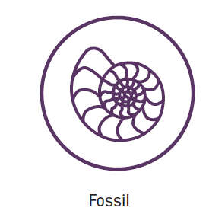
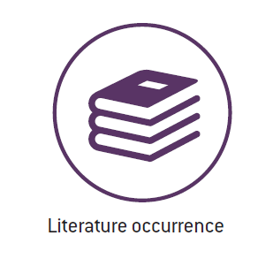
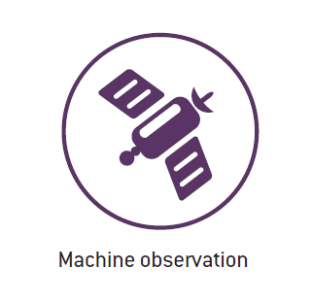
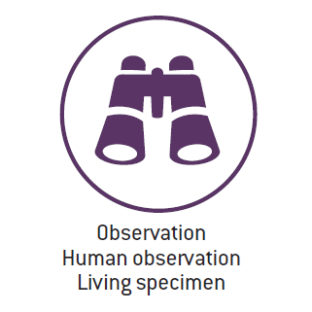
what
Types of data shared through GBIF
http://www.gbif.org/occurrence

Slide 6
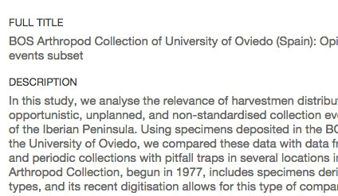
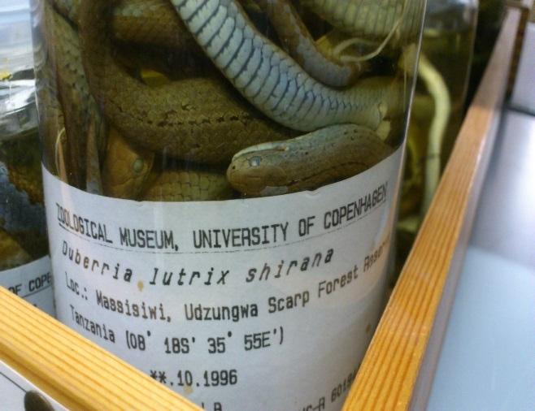
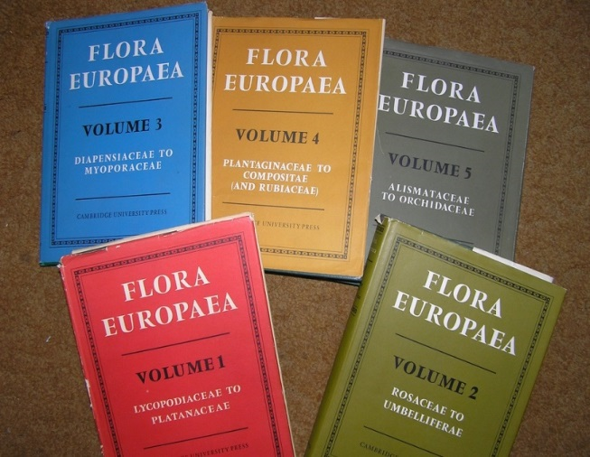
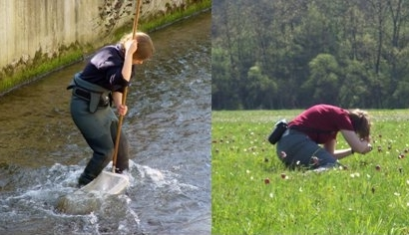
Data richness levels supported by GBIF
1.
Catalogue of collections
3.
Species with dates and coordinates
Collection Metadata
Species Occurrences
2.
Species in countries and areas
4.
Species with dates, coordinates, methods, abundance and absence etc.
Species Checklists
Sampled Organisms
http://www.gbif.org/publishing-data/summary#datatypes
Notes:
GBIF now deals with four types of biodiversity data:
Occurrences (observations, specimens etc)
Samples (sets of observations from a single collecting event, including information on sampling protocols and abundance)
Checklists (names)
Metadata (data about data) - http://www.gbif.org/dataset/search?type=METADATA
Occurrences are records that document a 'collection event'—evidence that a particular, named organism was found at a particular time and place. Also known as primary biodiversity data, occurrences document the 'what, where, when, how and by whom' of our exploration of the planet's species. An occurrence record can be based on an observation in the field, vouchered (labeled) specimen in a museum or herbarium, or other evidence.
Sample-based data are records from thousands of different kinds of environmental, ecological, and natural resource monitoring and assessment investigations. These events range from one-off surveys to ongoing monitoring and includes activities like freshwater and marine sampling, plant cover and vegetation plots, and citizen science bird counts, among others.
Checklists are lists of scientific names of organisms grouped into taxonomic hierarchies. They serve two main functions: first, they provide data that help to enrich information about particular species, for example by including them on national checklists, and on lists of invasive or threatened species; and they provide taxonomic 'backbones' around which species information can be organized.
Metadata are structured descriptions of datasets giving essential details such as the geographic and taxonomic scope of the data, methods of collection or observation, contact details and citation requirements. They help to give context to datasets and enable users to assess whether data are fit for use in a particular research project or application.

Slide 7
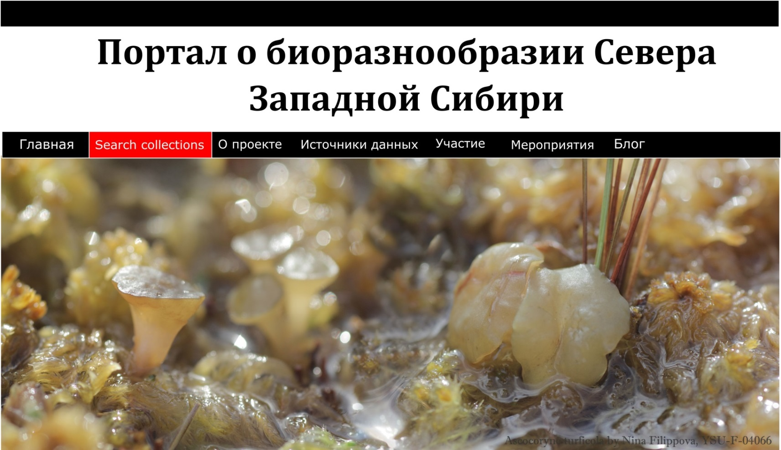
Regional program on data digitization and mobilization in Northern part of WS
Registered in GBIF organizations (WS)
Tyumen State University
Tigirek State Nature Reserve
Central Siberian Botanical Garden SB RAS
Katunskiy Biosphere Reserve
Altai State University
Sibecocenter LLC
REGISTERED IN GBIF ORGANIZATIONS (Yugra)
Yugra State University
Uganskiy Nature Reserve
Malaya Sosva Nature Reserve
Kondinskie Ozera Nature Park
Museum of Nature and Man
Ecocenter (Megion)
Surgut State University (in plans)
Nizhnevartovsk State University (in plans)
https://nwsbios.org/

Slide 8
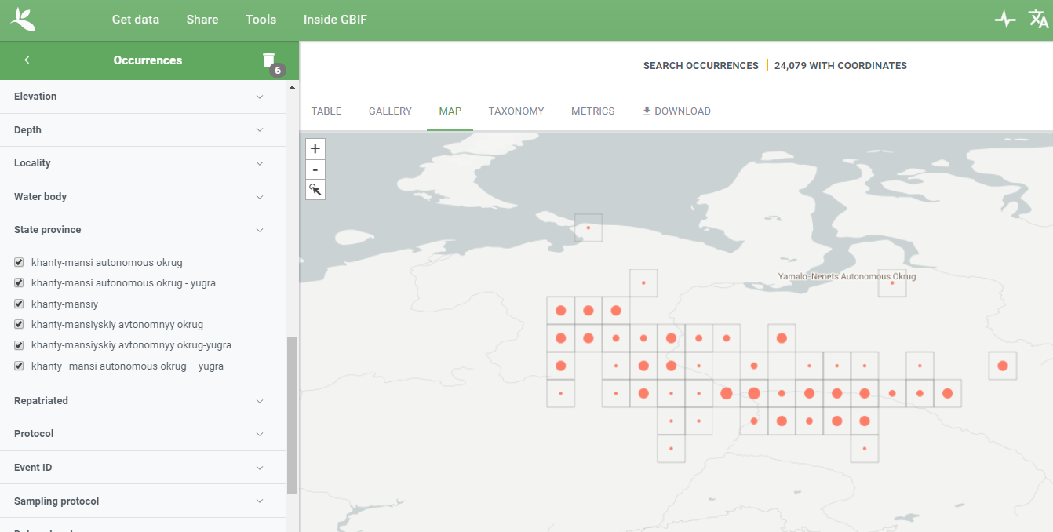
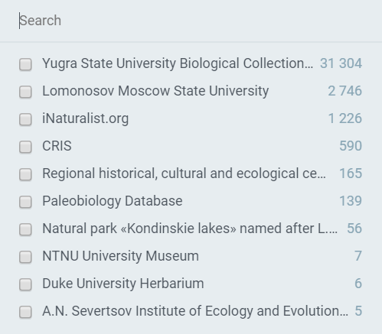
Yugra in GBIF: 36 thousand observations, 6 registered organizations
Publishers:
https://www.gbif.org/occurrence/map?state_province=khanty-mansi%20autonomous%20okrug

Slide 9
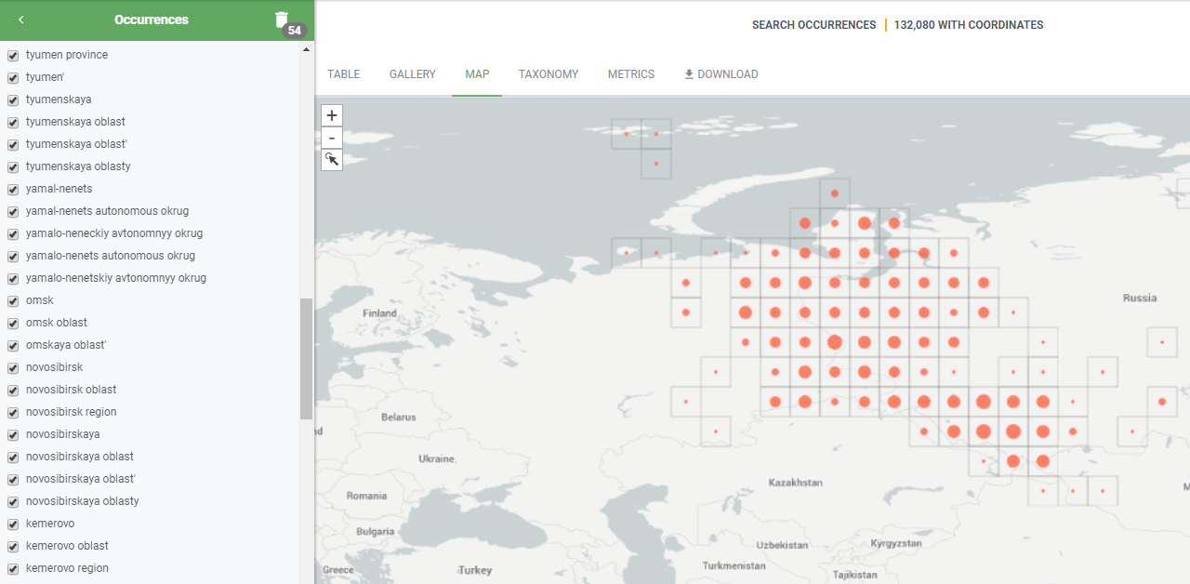
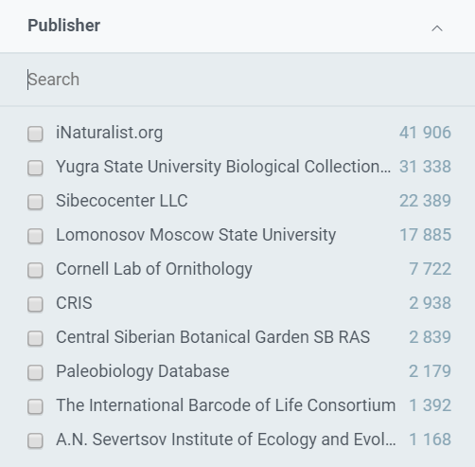
Western Siberia in GBIF:
10 administrative regions, 8 registered organizations: about 140 thousand observations
Region | Number of observations in GBIF
Altay s.l. (kray + respublica) | 55105
Khanty-Mansiysikiy AO | 34151
Novosibirskaya oblast' | 16788
Yamalo-Nenetskiy AO | 9377
Tomskaya oblast' | 7925
Omskaya oblast' | 6423
Kemerovskaya oblast’ | 4769
Tyumen oblast' (s.l.) | 3774
Kurganskaya oblast' | 1017

Slide 10
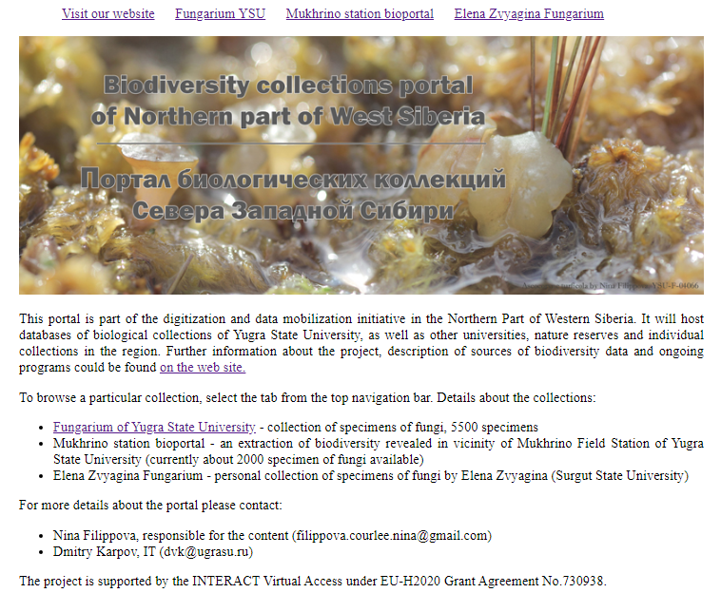
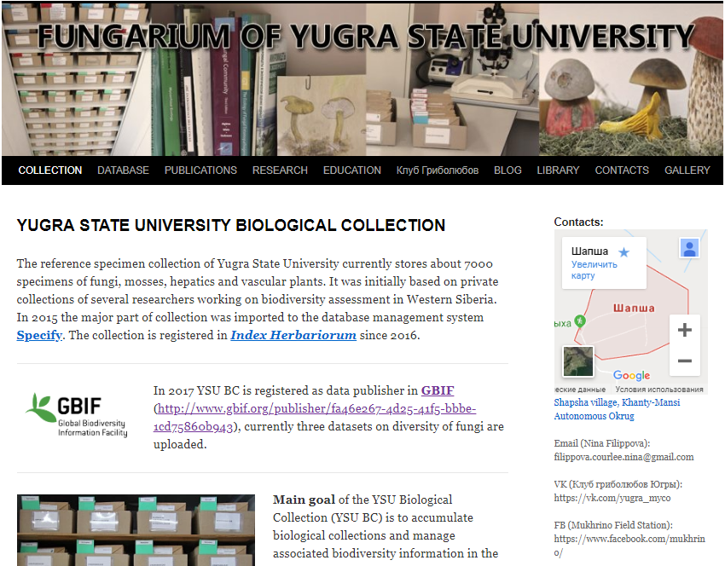
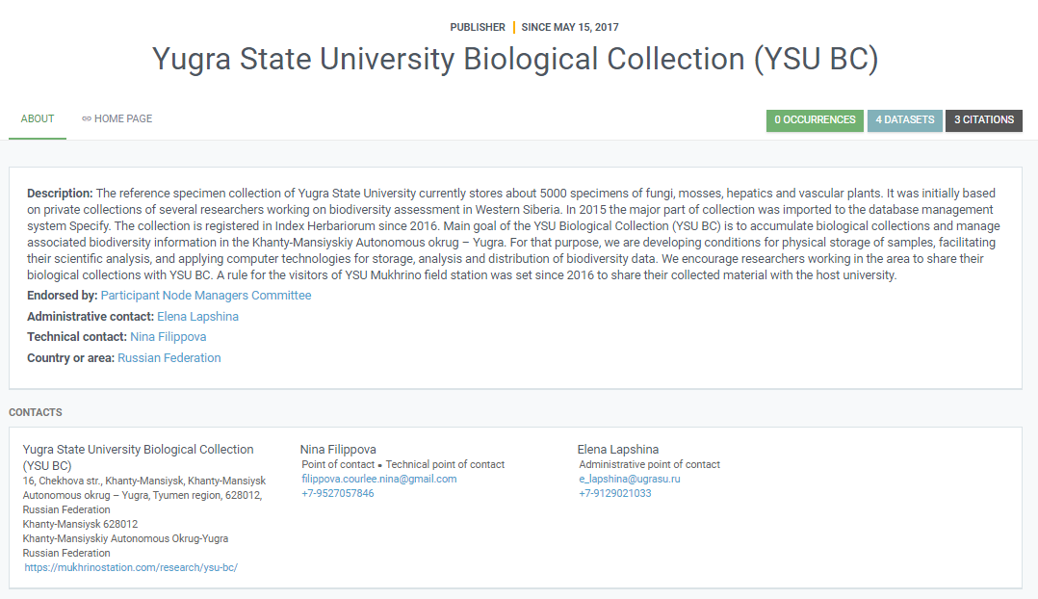
Examples of data mobilization by
the Biological collection of Yugra State University:
Biological collection database
https://fungariumysu.org/ysu-bc

Slide 11
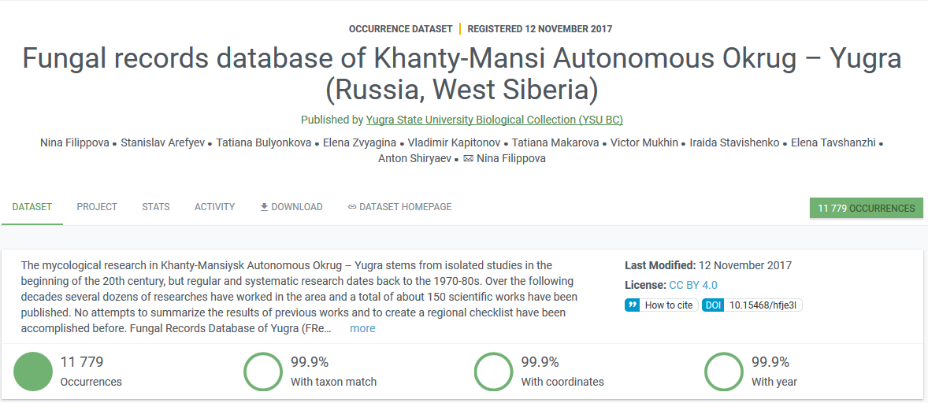
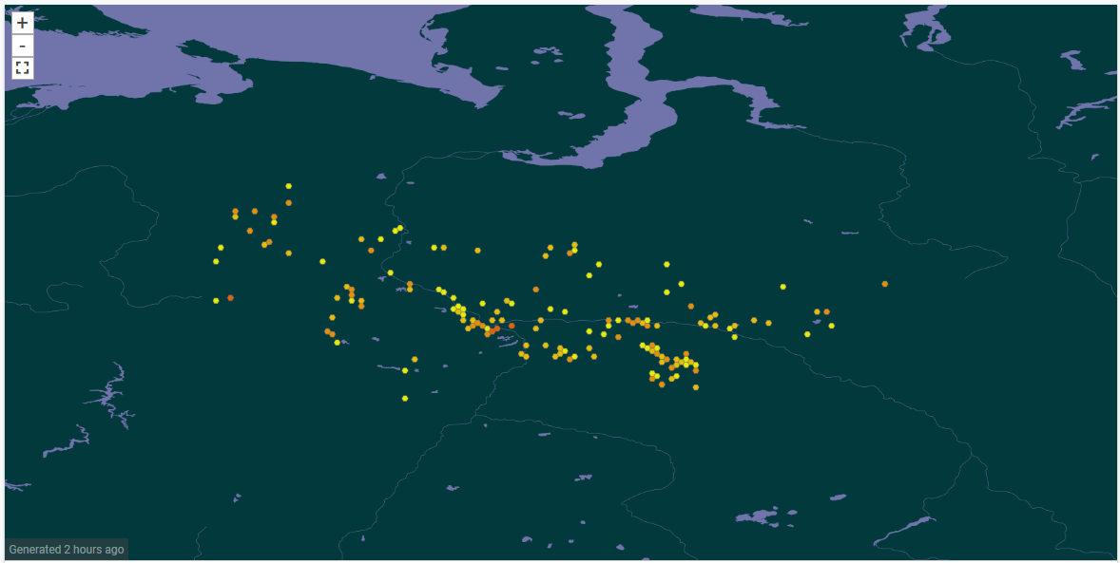
Digitization of literature data: Fungal records database of Yugra region
https://fungariumysu.org/fredy
Filippova N.V., Arefyev S.P., Bulyonkova T.M., Zvyagina E.A., Kapitonov V.I., Makarova T.A., Mukhin V.A., Stavishenko I.V., Tavshanzhi E.I., Shiryaev A.G. 2017. The history of mycological studies in Khanty-Mansi autonomous okrug: 1) the period of isolated studies, lignicolous basidiomycetes and phytopathological studies // Environmental dynamics and global climate change. V. 8. No. 2. P. 18-28. URL: http://journals.eco-vector.com/EDGCC/article/view/7132 [in Russian with English abstract]

Slide 12
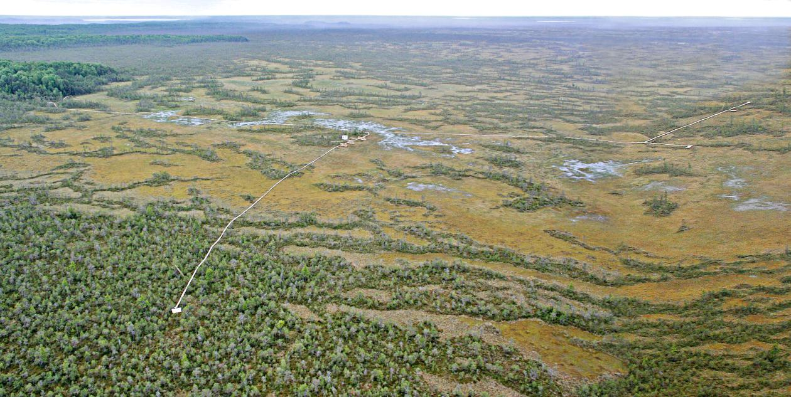
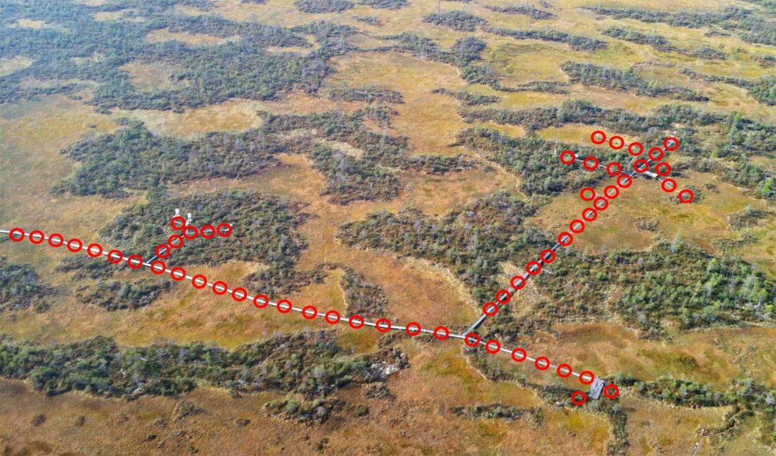
Quantitative (sampling event) data: mobilization of geobotanical descriptions and plot-based observations of macrofungi
Lapshina E, Ganasevich G, Vasina A, Filippova N (2019). Vegetation releves of rich fens of Malaya Sosva Nature Reserve. Version 1.3. Malaya Sosva State Nature Reserve. Sampling event dataset https://doi.org/10.15468/hpjiw9 accessed via GBIF.org on 2019-09-26.
Filippova N (2019). The communities of terrestrial macrofungi in different forest types of boreal zone in West Siberia. Version 1.7. Yugra State University Biological Collection (YSU BC). Sampling event dataset https://doi.org/10.15468/ge1hkl accessed via GBIF.org on 2019-09-26.
Filippova N (2019). Plot-based observations of macrofungi in raised bogs in Western Siberia. Version 1.21. Yugra State University Biological Collection (YSU BC). Sampling event dataset https://doi.org/10.15468/e9g5ri accessed via GBIF.org on 2019-09-26.

Slide 13
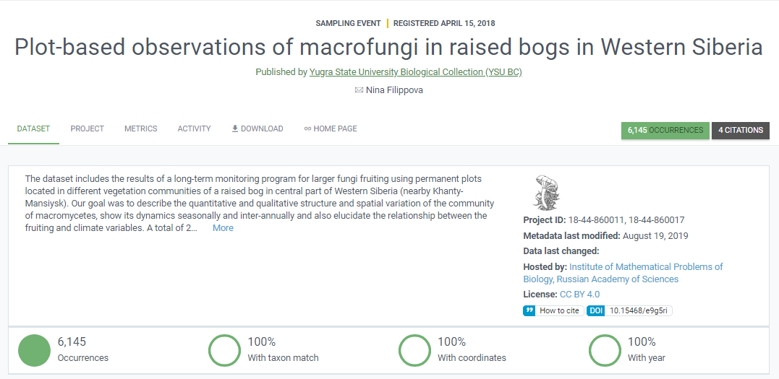
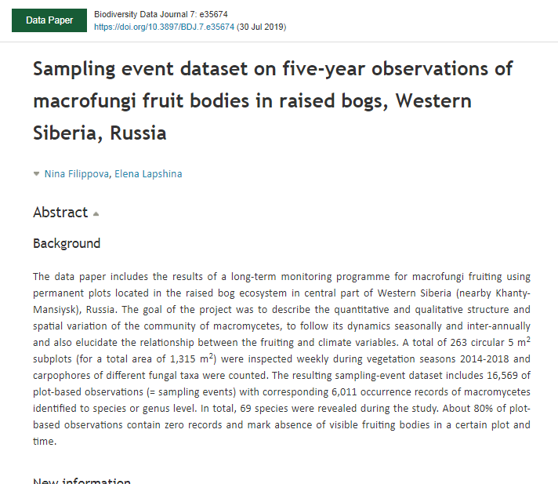
Data papers based on GBIF-published datasets

Slide 14
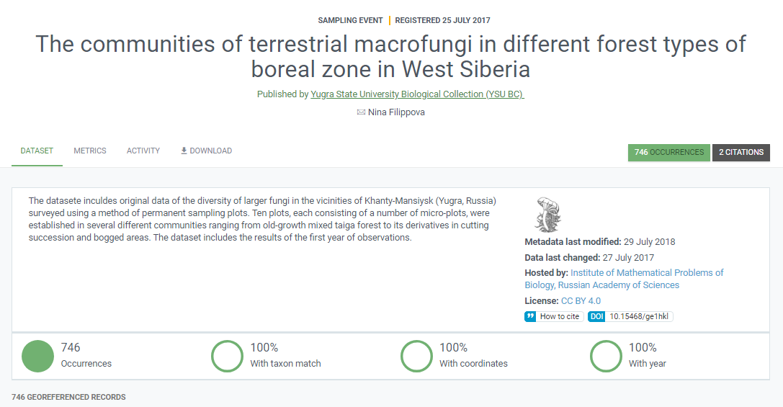
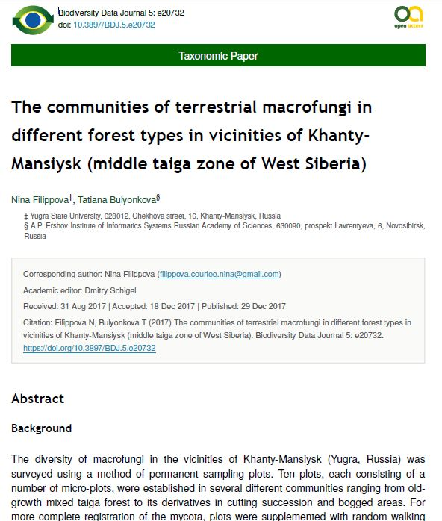
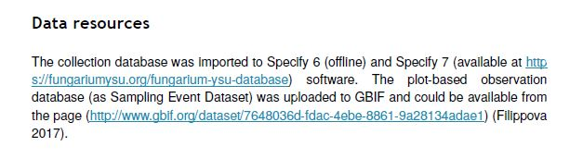
Scholarly papers based on GBIF-published datasets and citation guide:

Slide 15
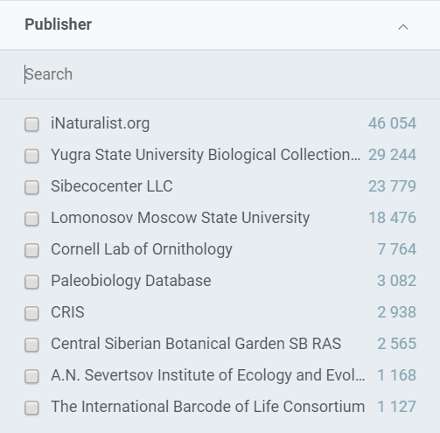

iNaturalist: citizen science-based observations for West Siberia
32 % of all occurrences
in WS published in GBIF
https://www.inaturalist.org/

Slide 16
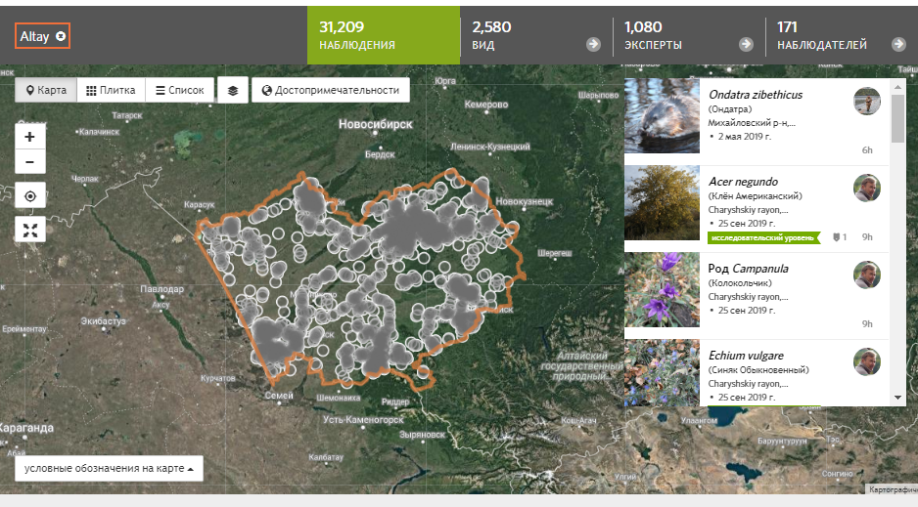
Number of observations on iNaturalist by regions
Region | Number of iNat observations
Altayskiy kray | 31209
Novosibirskaya oblast' | 12106
Omskaya oblast' | 6082
Tomskaya oblast' | 5428
Respublica Altay | 3609
Khanty-Mansi AO | 2470
Tyumen oblast' | 1533
Kurganskaya oblast' | 1436
Yamalo-Nenetskiy AO | 1368

Slide 17
Biodiversity portal of Northern part of West Siberia ?
Support of data mobilization initiatives:
The project is partially funded by the Yugra State University grant number 13-01-20/39.
The project is partially supported by the INTERACT Virtual Access under EU-H2020 Grant Agreement No.730938.
19-44-890006 (РФФИ р_а 2019) Информационный портал «Биоразнообразие Севера Западной Сибири»: оцифровка и мобилизация данных о биоразнообразии региона (заявка отправлена)
19-2-011332 (Фонд президентских грантов 2019) Информационный портал по биоразнообразию «Живая Югра» (заявка отправлена)
18-44-860011 (РФФИ р_а 2018) Информационный портал «Биоразнообразие Югры»: оцифровка и менеджмент биологических коллекций и интеграция региональных данных в национальные и глобальные системы (не поддержана)
19-1-000359 (Грант Губернатора Югры 2019) Информационный портал по биоразнообразию «Живая Югра» (не поддержана)

Slide 18
Thank you for your attention!
Сайт о Глобальной информационной системе по биоразнообразию в России http://gbif.ru/
Научная конференция «Информационные технологии в исследовании биоразнообразия» (20-22 апреля 2020, Екатеринбург) http://insma.urfu.ru/conf/itbio
Портал о биоразнообразии Севера Западной Сибири https://nwsbios.org

